Slide 2
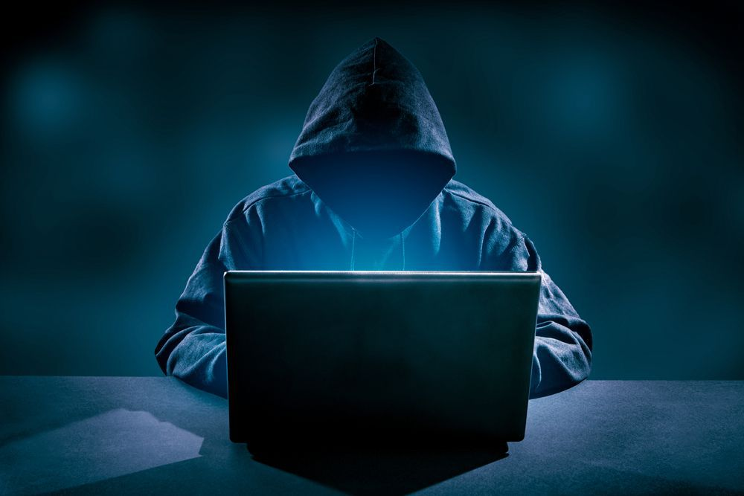
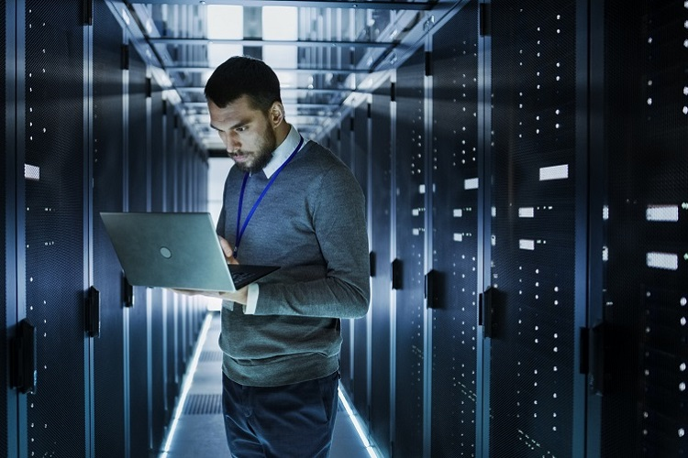
Hardcore hacker vs Awesome IT-Pro Battle Royale!
Notes:
O/K

Slide 3



Who we are
Oddvar Moe / Karim El-Melhaoui
Working for Advania
Microsoft oriented security
Offensive
Defensive
Awesome IT-PRO
Hardcore Hacker
Notes:
Oddvar introduces himself, briefly explains what he works with, related to security, position and experience.
Karim:
My name is Karim El-Mel-Ha-Wee, good luck spelling that btw... I work as aT echnical Architect in Advania, helping orgs. Implement defensive security measures and cloud infrastructure.

Slide 4
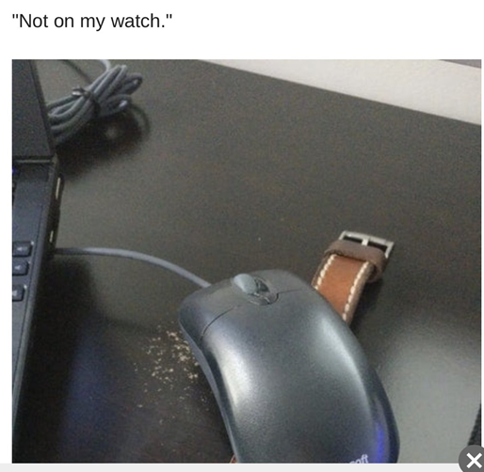
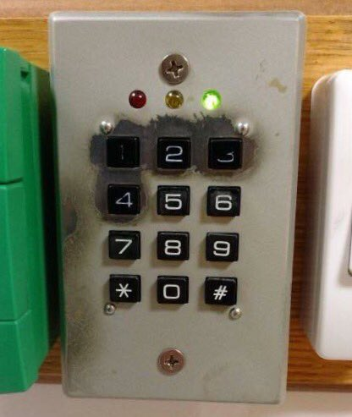
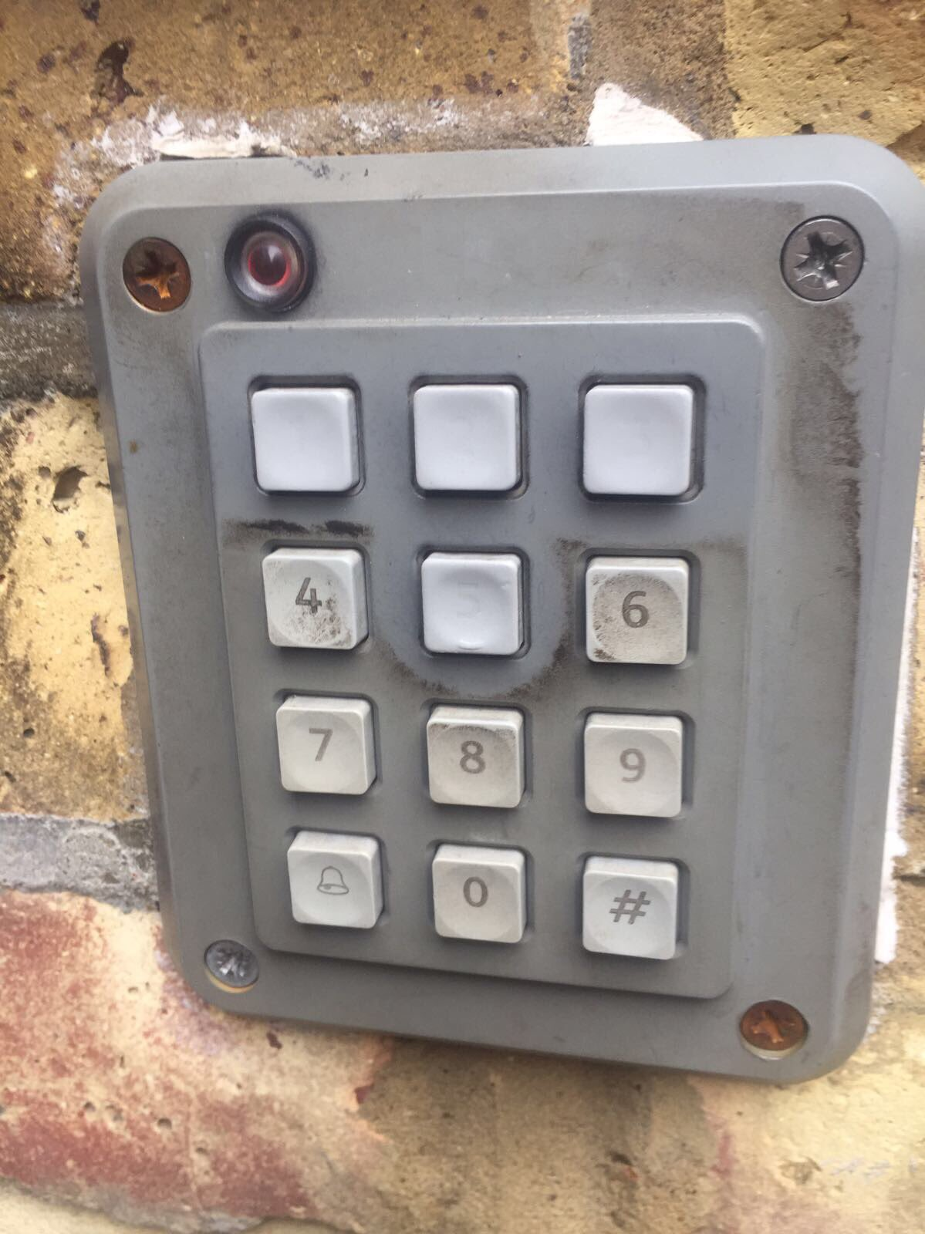
Security is hard!
Notes:
O

Slide 5
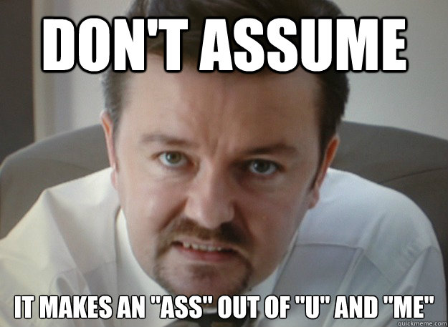
Purpose
Methodology
Assumption is the mother of all f***ups
Knowledge sharing
Provide takeaways!
Notes:
Oddvar
Methodology:/Prove effective security measures
Backup vs Antivirus
Implementing and practicing security in Windows, by actually challenging the security measures implemented.
Assumption:
Assumption is the mother of all fuckups, who would have assumed root password for all Mac’s were blank for so many years? Often we implement measures in the belief that something is accepted as true or certain to be.
Q: How many of you have actually tested your antivirus? You just assume it’s working, dont you?
Karim:
Knowledge:
We want to share our research with everyone in the room, so you can apply this to your environment.
Theres nothing better than leaving a session with a «To-do list».

Slide 6
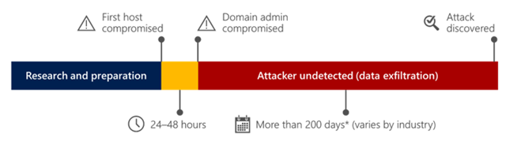
24-48 HOURS!
Notes:
Relate to real Pentests

Slide 7
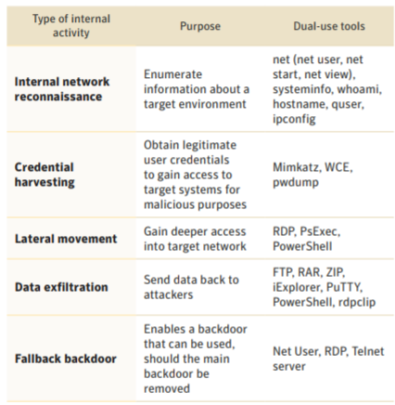
Threat model
«Living off the land»
Blend into the network
Stay in memory
https://www.symantec.com/content/dam/symantec/docs/security-center/white-papers/istr-living-off-the-land-and-fileless-attack-techniques-en.pdf
https://www.youtube.com/watch?time_continue=3&v=j-r6UonEkUw
Notes:
Slide to describe defenses applied in first round.

Slide 8
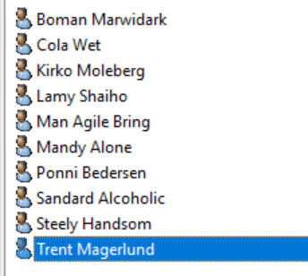
Environment
Notes:
K
Briefly explain the environment.
Legger inn bilde av brukere

Slide 9
Attacks and mitigations: Round 1
NTLM LEAK
Macro – Shellaccess
DDEAuto - Shellaccess
Notes:
O
Slide to describe defenses applied in first round.

Slide 10
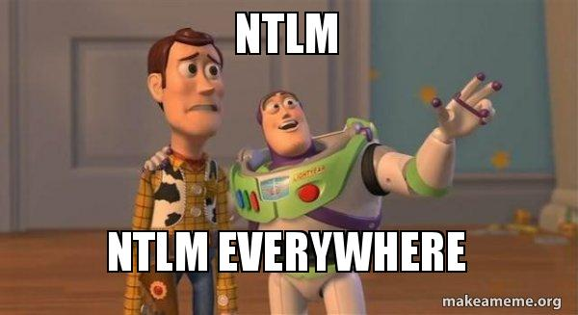
Details about attacks – NTLM leak
Bug in Windows from 1997 (Thanks Aron Spangler)
Affects most products
How to exploit
\\IP\share\file
Office files (Frameset, subdoc and more)
Icon files on shortcuts
+++
Notes:
O

Slide 11
Details about attacks – NTLM leak
UNC in mail
UNC in subdoc
2 Mails
NTLM HASH IN RETURN
Notes:
O
Slide to describe defenses applied in first round.

Slide 12
DEMO – NTLM LEAKING
Notes:
DEMO VIDEO 1 – NTLM LEAK WITH PICTURE IN MAIL

Slide 13
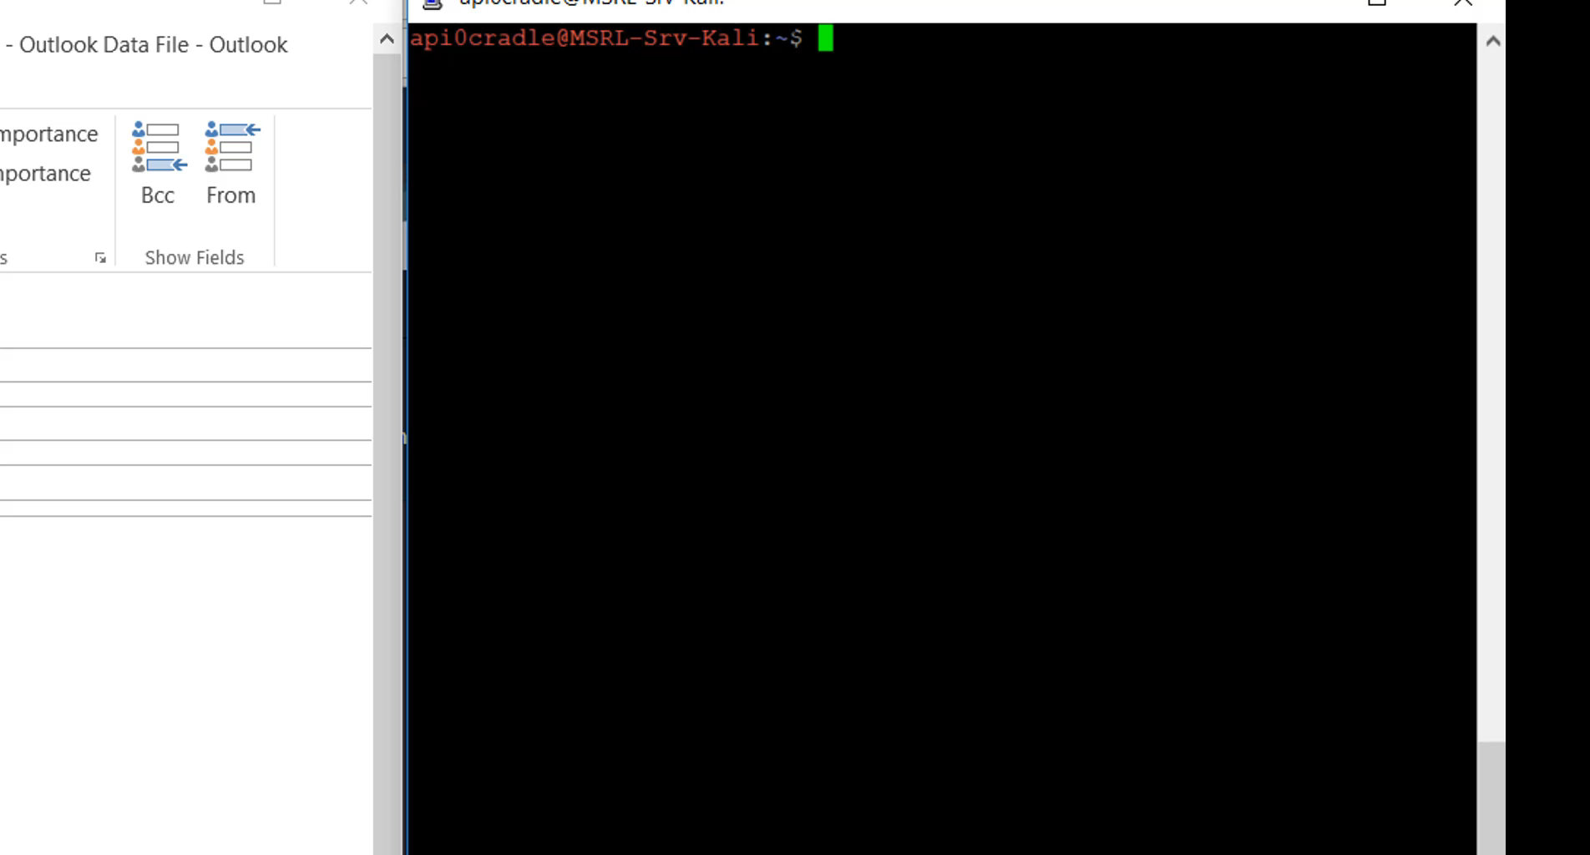
Attacks round 1
Notes:
DEMO VIDEO 1 – NTLM LEAK WITH PICTURE IN MAIL

Slide 14
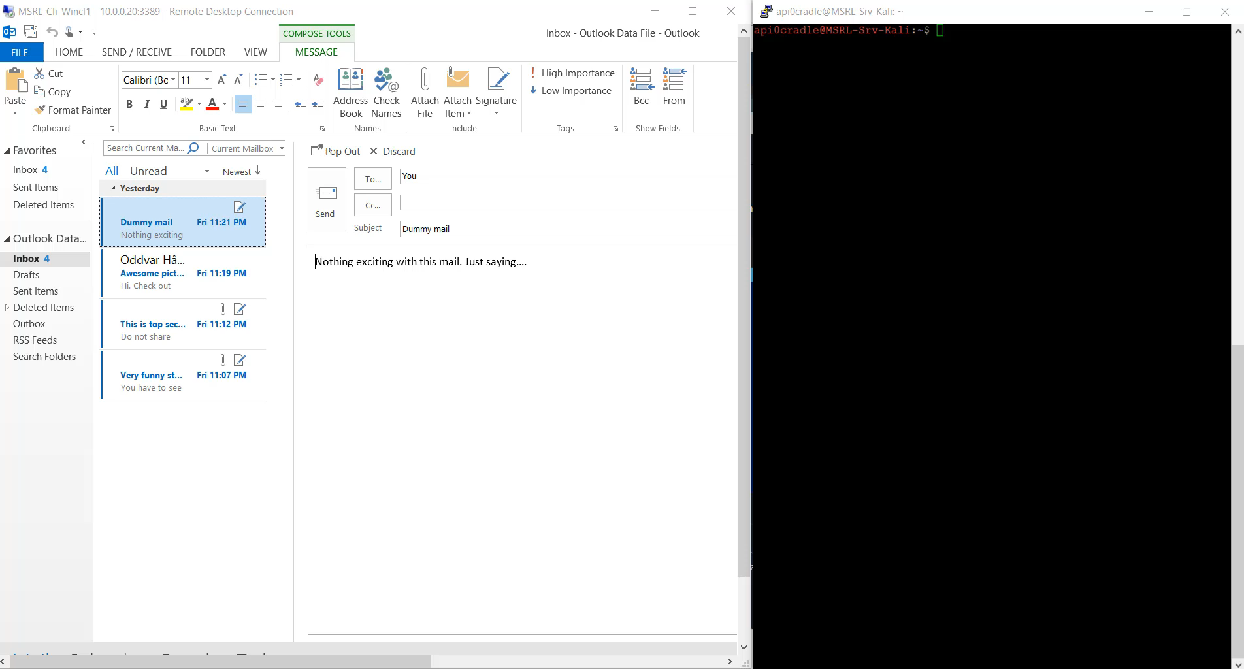
Attacks round 1
Notes:
DEMO VIDEO 2 – NTLM LEAK WITH DOCX

Slide 15
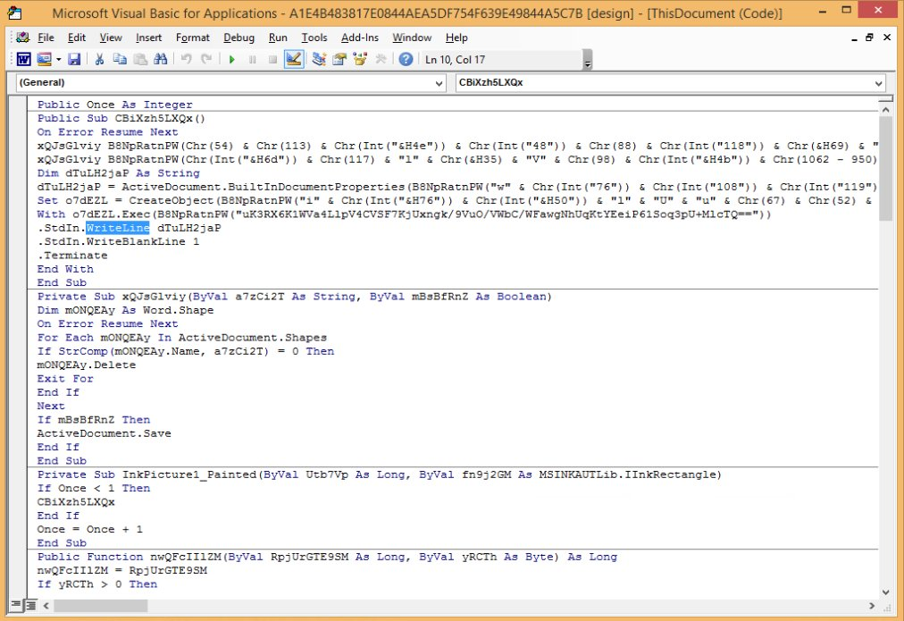
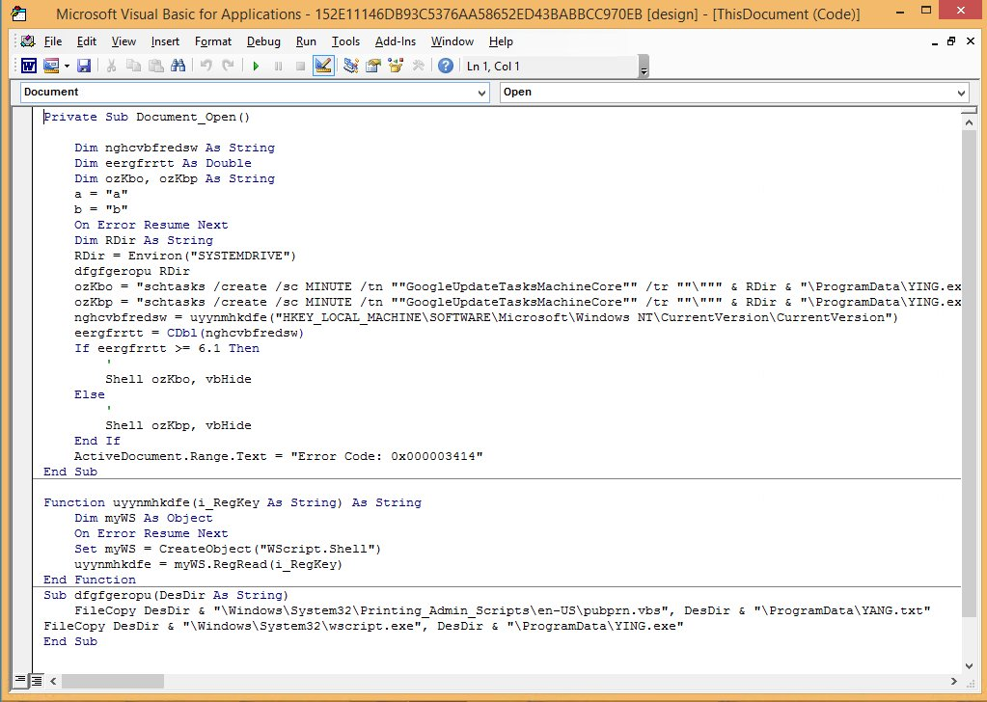
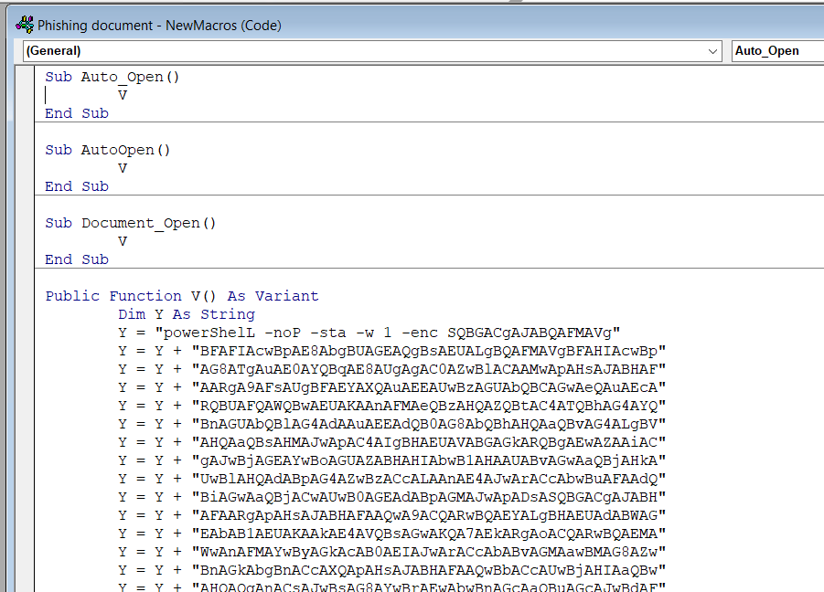
Details about attacks – Macro
Some examples:
For more
@JohnLaTwC
Notes:
Slide to describe defenses applied in first round.

Slide 16
Details about attacks – Macro
ALLOW MACRO TO RUN
OPEN ATTACHMENT
PHISHING MAIL
EMPIRE AGENT
Notes:
Slide to describe defenses applied in first round.

Slide 17
DEMO – MACRO PHISHING MAIL
Notes:
DEMO VIDEO 3 – PHISHING MAIL - EMPIRE

Slide 18
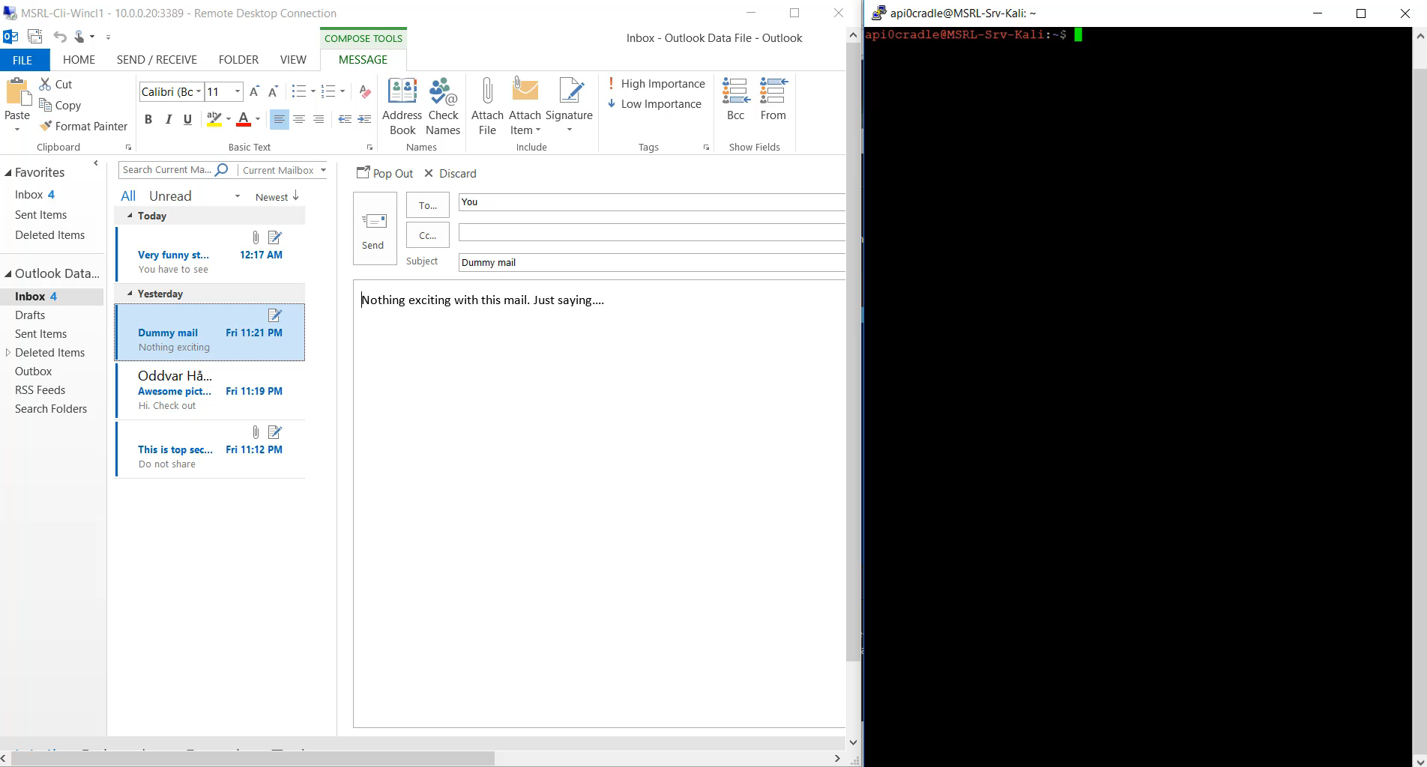
Attacks round 1
Notes:
DEMO VIDEO 3 – PHISHING MAIL - EMPIRE

Slide 19
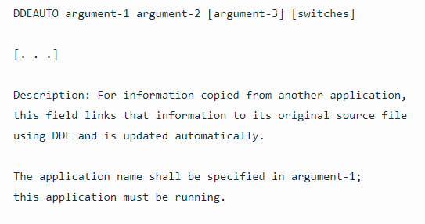
Details about attacks – DDEAuto
Usage – getting data
Possible to execute code - Etienne Stalmans – Matt Nelson
{ DDEAUTO c:\\windows\\system32\\cmd.exe "/c calc.exe" }

Slide 20
Details about attacks – DDEAuto
OPEN ATTACHMENT
ANSWER YES 2X
PHISHING MAIL
EMPIRE AGENT
Notes:
Slide to describe defenses applied in first round.

Slide 21
DEMO – DDEAuto
Notes:
DEMO VIDEO 4 – DDEAuto - EMPIRE

Slide 22
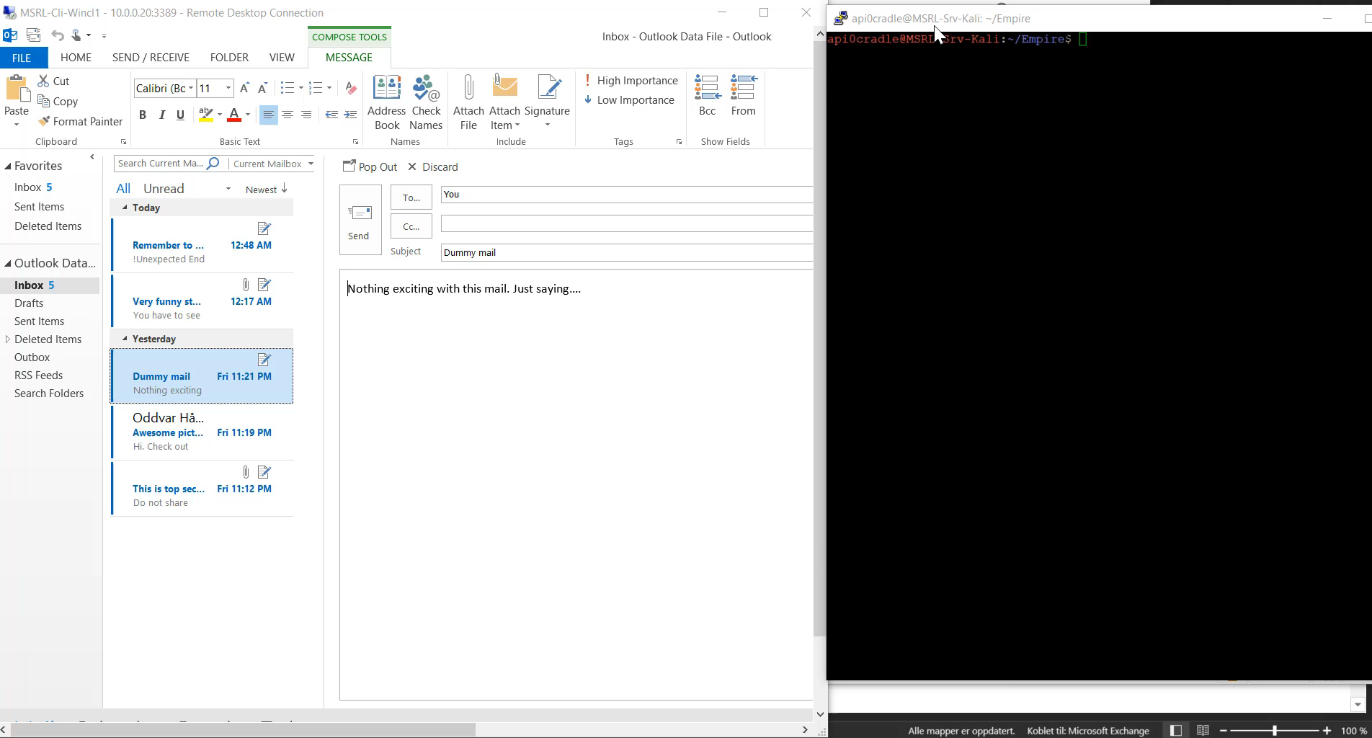
Attacks round 1
Notes:
DEMO VIDEO 4 – DDEAuto - Empire

Slide 23
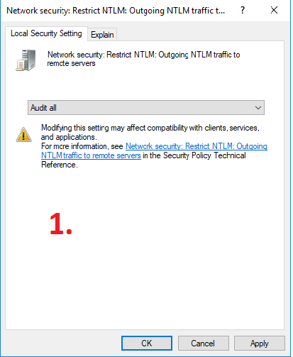
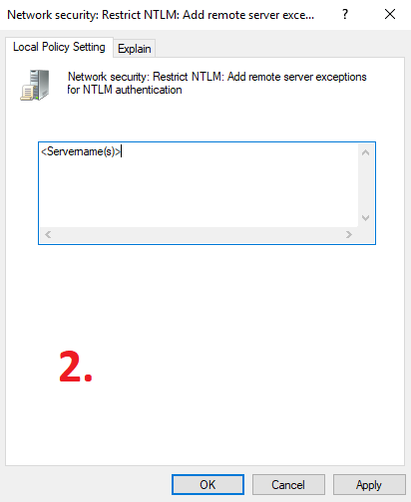
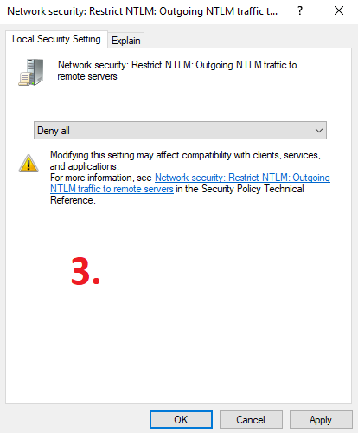
Mitigations – NTLM Blocking
Audit
Whitelist
Block NTLM
+10
Notes:
Slide to describe defenses applied in first round.

Slide 24
Mitigations – Office macro challenges
Commonly used for productivity
Macros can execute code
Users ignore security warnings
Notes:
Challenges:
Macros can execute code
Commonly used for producitivity
Users not familiar with risk
- and who are they to choose whether code should be allowed to run or not?
- Allowing end users to decide if code should run or not isnt a good idea.
Users ignore security warnings

Slide 25
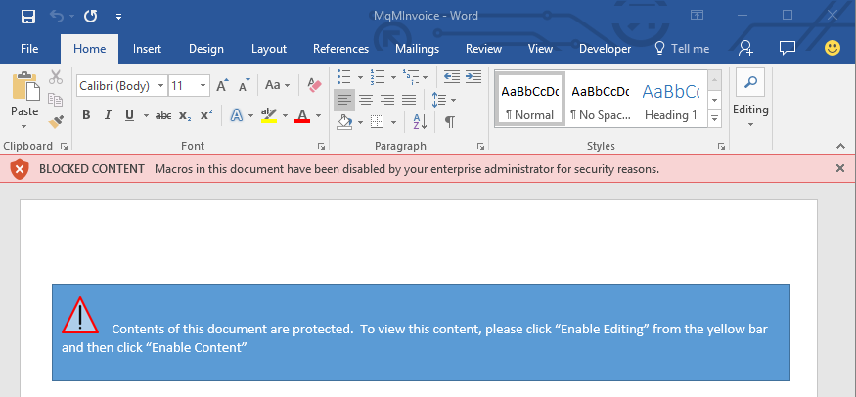
Mitigations – Office macro exploits
Attack Surface Reduction (Windows 10 1709)
Block macros originating from Internet (Office)
Don’t trust anything
Notes:
Challenges:
Macros can execute code
Commonly used for producitivity
Users not familiar with risk
Users ignore security warnings

Slide 26
Mitigations – DDEAuto
Functionality removed by Office patch(es)
Requires manual attention
ADV170021 | Microsoft Office Defense in Depth Update
Notes:
Slide to describe defenses applied in first round.

Slide 27
DEMO – Defense
Notes:
DEMO DEFENSE KARIM

Slide 28
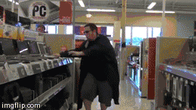
Attacks and mitigations: Round 2
Escalate to local admin
Lateral movement
Notes:
shell type c:\windows\panther\unattend.xml
usemodule management/spawnas
set Username Administrator
Set Password SpiceGirls1!
Set Listener https
usemodule lateral_movement/invoke_wmi

Slide 29
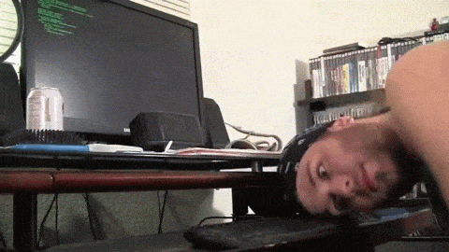
Details about attacks – Escalate privileges
Increase privileges
Various methods
Wrong ACL on services/Autoruns
GPP passwords
Unattend.xml
Kerberoasting
DLL Hijacking <3
+++++
Notes:
Slide to describe defenses applied in first round.

Slide 30
DEMO – Elevate privileges
Notes:
DEMO VIDEO 4 – DDEAuto - EMPIRE

Slide 31
Details about attacks – Lateral movement
Jump between computers
Search for more/better creds
Different techniques
WMI
PSRemoting
PSEXEC
DCOM

Slide 32
DEMO – Lateral movement

Slide 33
Mitigations: Round 2
Notes:
Slide to describe defenses applied in first round.

Slide 34
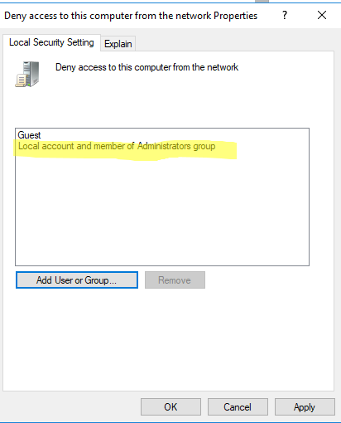
Mitigating lateral movement – Lateral Movement
Limit workstation communication
Introduced in Server 2012 (Windows 7: KB2871977)
Firewall rules
Notes:
Slide to describe defenses applied in first round.

Slide 35
Mitigating lateral movement – LAPS
Local accounts are invisible in DC logs
Randomizes RID 500 account password
Managed with Group Policy
Stored in attribute
Notes:
Slide to describe defenses applied in first round.

Slide 36
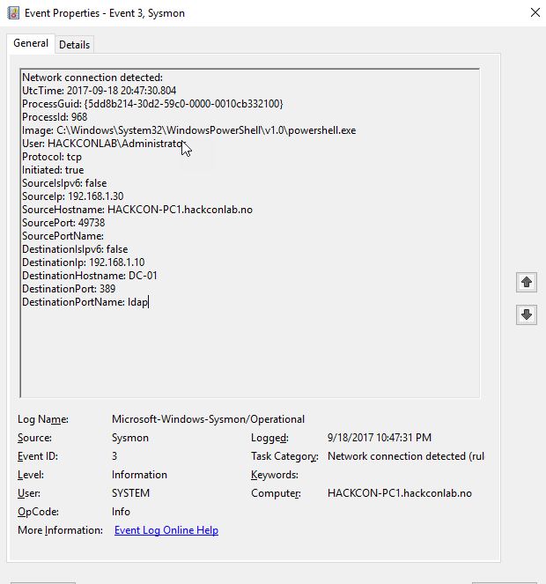
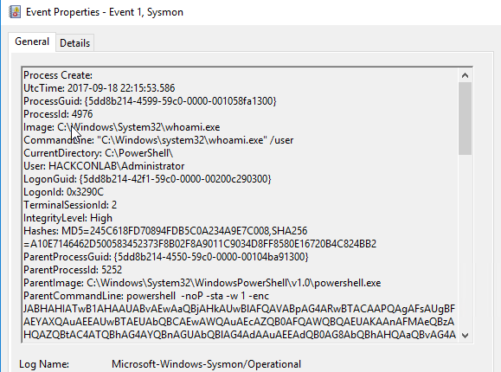
Monitoring & Detection – Sysmon
Notes:
Slide to describe defenses applied in first round.

Slide 37
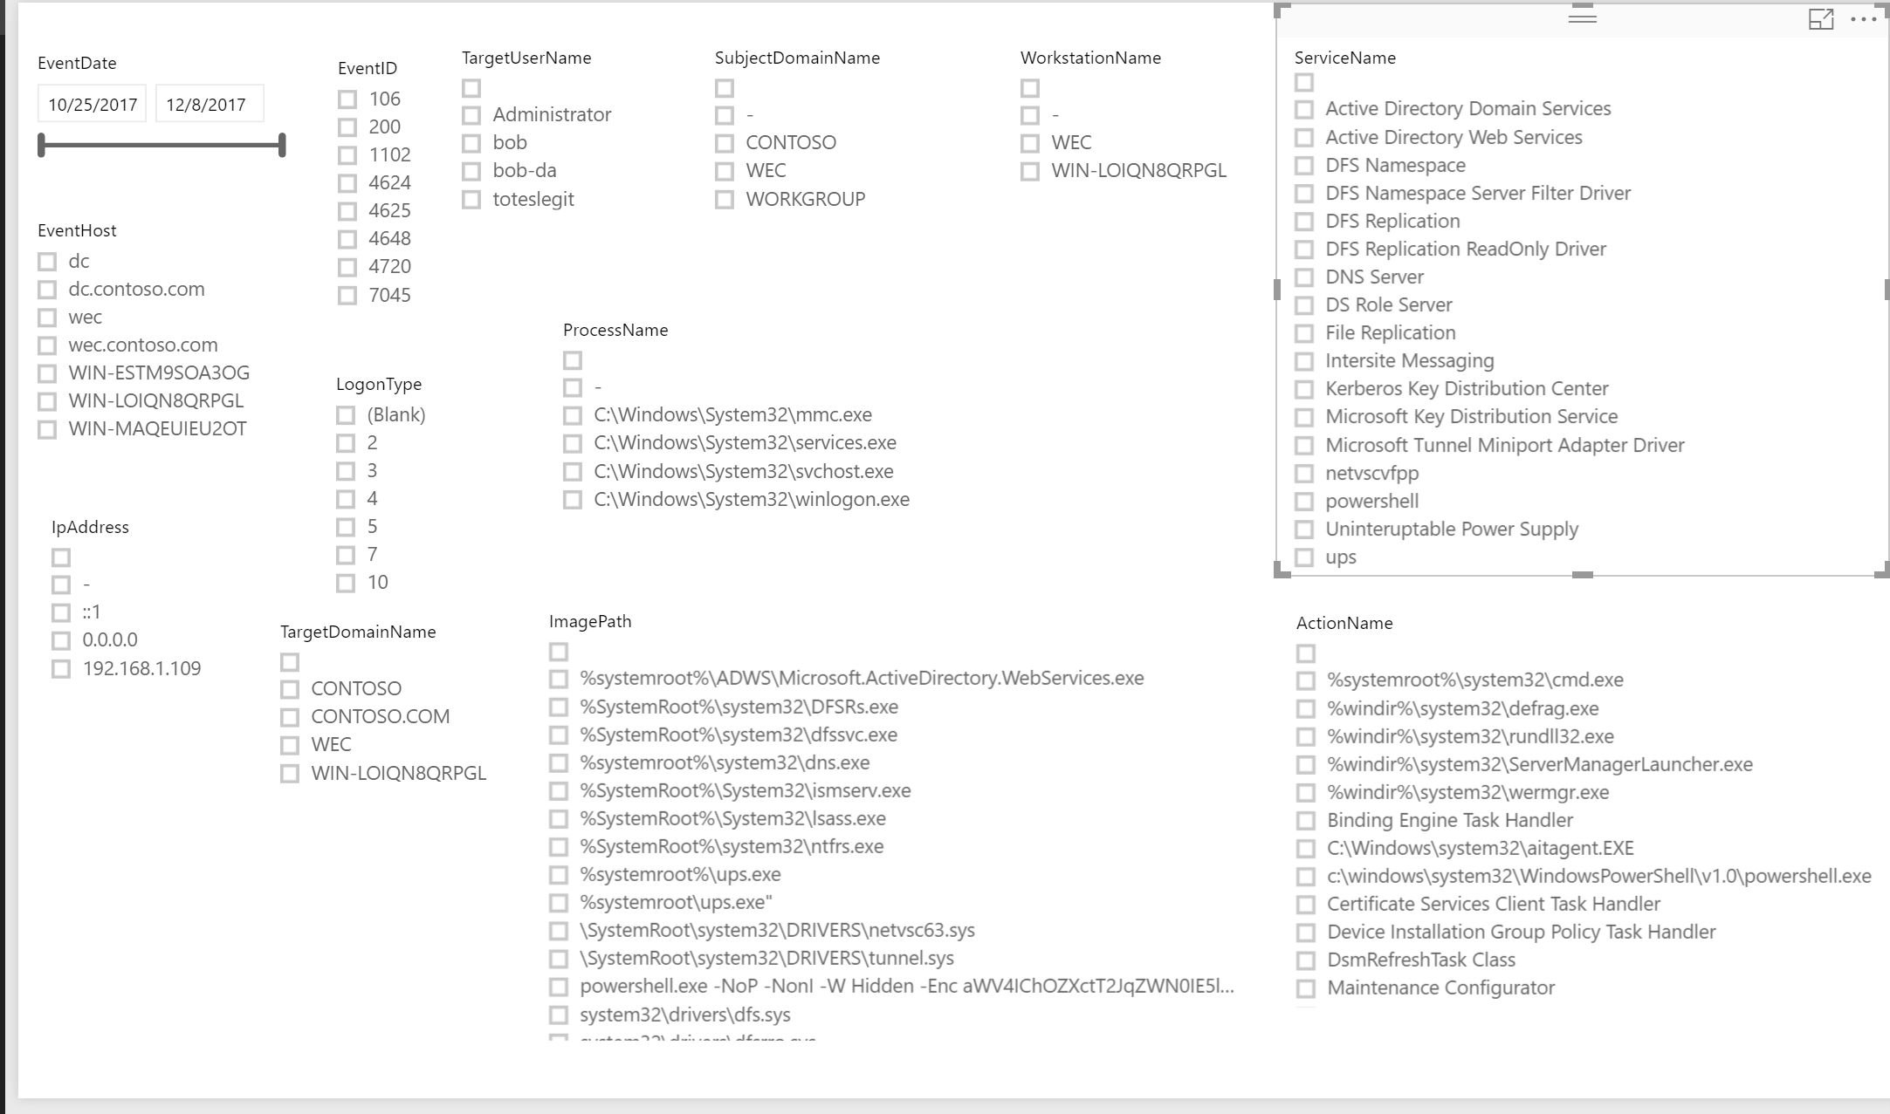
Monitoring & Detection – aka.ms/Weffles
Notes:
Slide to describe defenses applied in first round.

Slide 38
Defense in-depth
LAPS
AppLocker
Monitoring
Local admin
Security Baselines
Related sessions: Flip the Script: PowerShell \"Microsoft\'s Incident Response Language\“ – Jared Atkinson 02/02 08:30 Implementing AppLocker Whitelisting in an Enterprise – Sami Laiho 02/02 08:30 Adventures in Underland: Is encryption solid as a rock or a handful of dust? – Paula Januszkiewicz 02/02 09:50
How the new Windows 10 Security Center Works with WDATP, Win-Defender and more - Mirko Colemberg 02/02 09:50 Top 10 ways to make hackers excited: All about the shortcuts not worth taking - Paula Januszkiewicz 02/02 12:40
Hacking Windows with Windows – Oddvar Moe 02/02 14:00 Stay ahead of cyber criminals – Watson for Cyber Security – Victor Grane 02/02 15:15

Slide 39
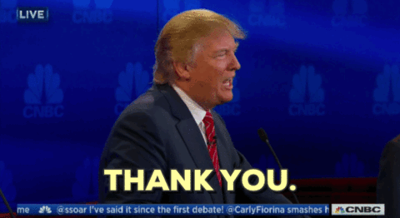
THANK YOU ALL!
Shoutouts:
Empire/PowerSploit teams
Sean Metcalf (Adsecurity.org)
Ned Pyle
Jessica Payne
Etienne Stalmans
Matt Nelson
MS Security guidance team
+ everyone we forgot…
Slides: github.com/nordicinfrastructureconference/2018 (bit.ly/2y7JhA3)

Slide 40
Resources
Slides and demos from the conference will be available at github.com/nordicinfrastructureconference/2018 (bit.ly/2y7JhA3)

